Slide 1


E-COMMERCE
OLIST STORE ANALYSIS
By: Fozia Mehtab

Slide 2

CONTENT
01
Introduction
02
Overview of Dataset
03
Data Description
04
General Insights from Data
05
Key Performance Indicators and Important Business Metrics with Insights
06
Conclusion
07
Recommendations

Slide 3
Introduction
Olist is a Brazilian e-commerce platform that connects small and medium-sized businesses to
customers across Brazil.
The dataset is designed to help analysts and researchers to better understand the e-commerce
landscape in Brazil and identify opportunities for growth and optimization.
The data analysis is performed using Excel, MySQL, Power BI and Tableau to check
the key performance Indicators and answer some business questions, thereby providing
Insights and recommendations to help Olist gain better insights into its e-commerce platform
and optimize available opportunities for growth.

Slide 4
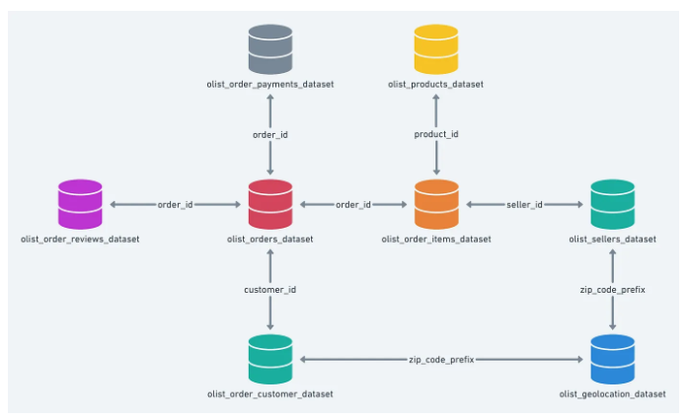





Overview of Data Set

Slide 5

Data Description
The data contains total 9 CSV files having information on 100,000 orders from 2016 to 2018 made at multiple marketplaces in Brazil.
The files provides details about order status, order items, customer geolocation, price, payment, product category and finally reviews written by customers.
The data is cleaned using power query editor for removing the unnecessary columns, duplicates and null values, as well as for correcting few names in few rows and then visuals were created to find out the key performance indicators as well as to provide some other important information regarding the business.

Slide 6
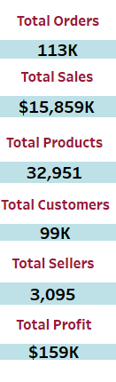
General Insights from Data
Olist has received 113k total orders from year 2016 to 2018.
Total sales is found to be $15,859k, out of which total profit margin is
$159k which is only 1% of total sales volume.
Total number of available products at Olist store is 32,951.
Total number of customers at Olist store is 99k.
Olist had total 3095 sellers from 2016 upto 2018.

Slide 7
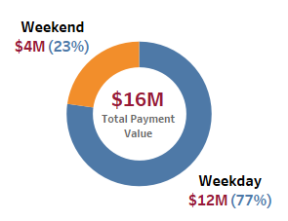
Weekday Vs. Weekend Sales
The present chart describes the sales pattern on weekdays and weekend.
It is found that out of total sales of $16M, week-end sale i.e; $4M(23%) is signifanctly lesser than week-days sale i.e; $12M(77%).
Therefore, as per this analysis, we can interpret that people prefer to buy more on week-days than
wee-end at Olist store.

Slide 8
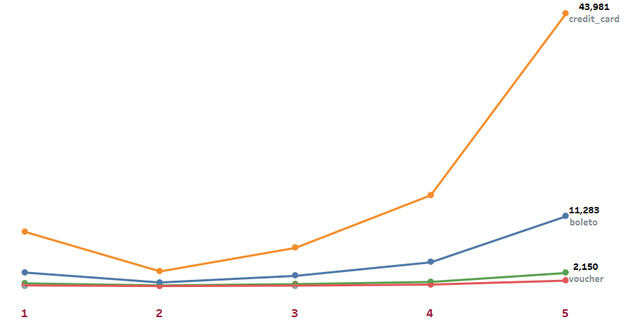
Orders with Review Score and Payment Type
It is found that out of four type of payment types, most of the orders i.e; 43,981 are paid through credit card.
Maximum review score i.e; 5 is also assigned to credit card payment type by the customers.

Slide 9
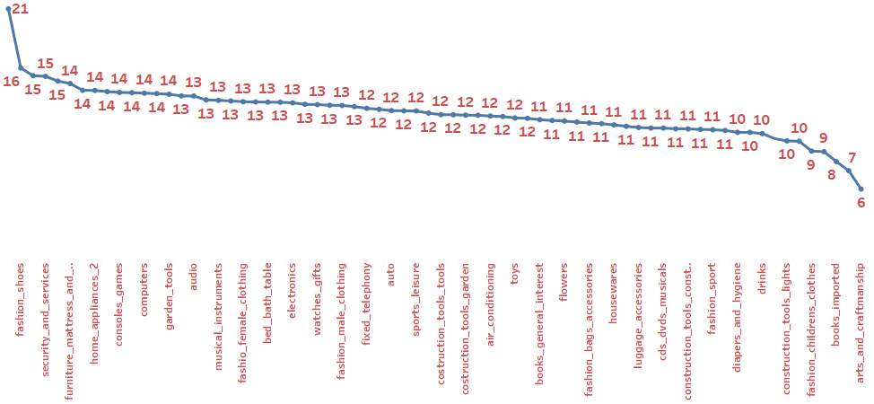
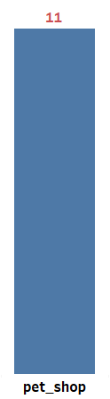
Average Shipping Days Vs. Product Categories
Maximum shipping days i.e; 21 is taken for the product category “fashion_shoes” and minimum time is taken for “arts and craftmanship”.
For “pet_shop” also shipping days are checked and its found that it takes 11 days to ship for the category “pet_shop”.

Slide 10
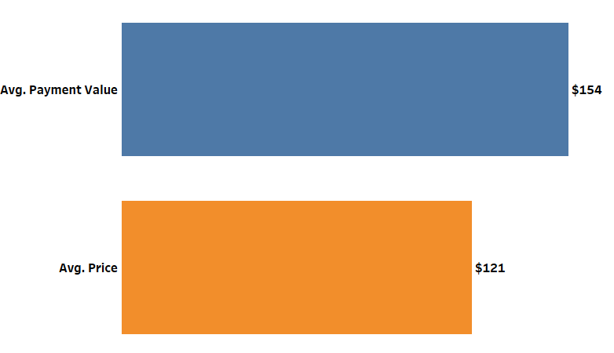
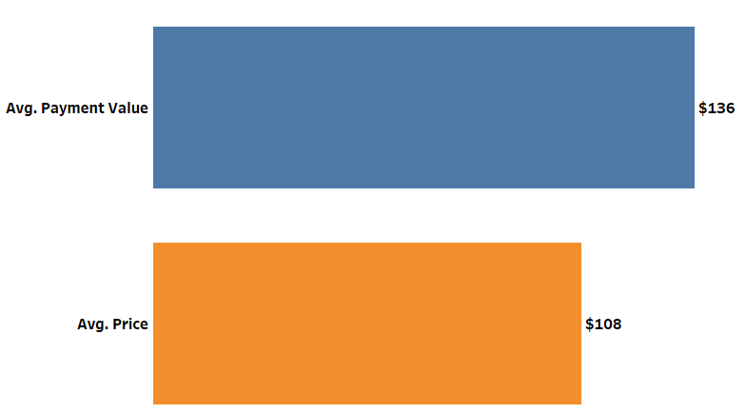
Average Payment Value vs. Average Price
It is found that total payment value amount is higher than the total price.
We have also checked the same for “sao_paulo” city by applying the value in customer city filter and found that average payment value is $136 and average price is $108 for sao_paulo.
Sao_Paulo city average payment value is 88% of total avg payment value and average price is 89% of total avg price thus it can be sen clearly that sao paulo city provides most of the business to Olist.

Slide 11
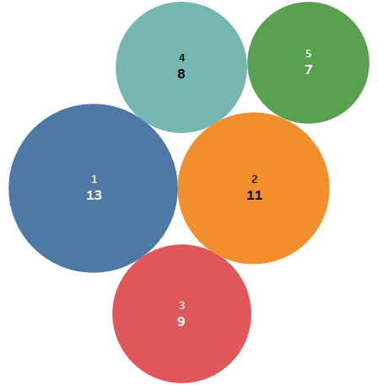
Shipping Days Vs. Review Scores
It can be seen from the chart that products which takes minimum ship i.e; 7 days have got maximum review score i.e; 5 and the one which takes maximum time for shipping, gotthe least score i.e; 1.
Therefore it can be interpreted there is an inverse relationship between shipping days and review scores provided by the customers.

Slide 12
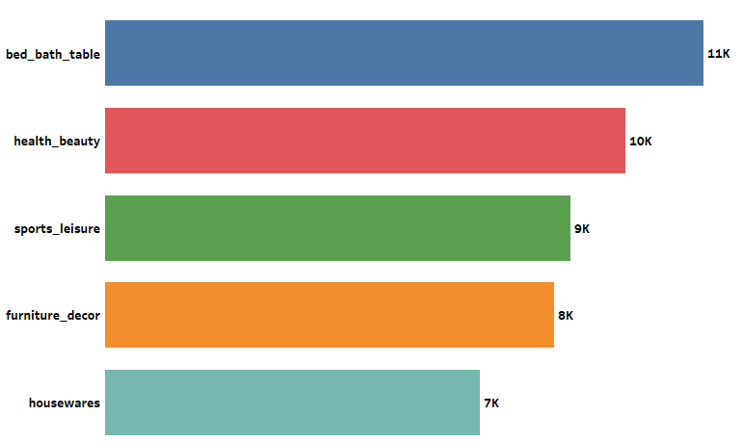
Top 5 Product Category by Order Counts
The present chart shows the top 5 product category by count of order items.
Here, it can be noticed that highest count of orders is found for the product
category “bed_bath_table” though it
was found on 2nd number of “top 5
product by revenue”.

Slide 13
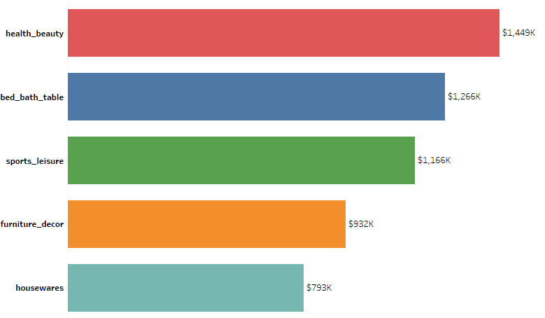
Top 5 Product Category by Revenue
The present chart shows the 5 top most revenue generating product categories .
It can be seen clearly that “health_beauty product category provides the highest revenue to
“Olist store”.

Slide 14
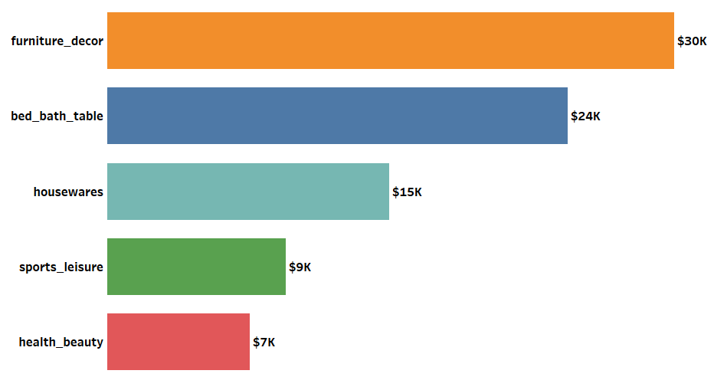
Top 5 Product Category by Profit
The present chart shows the 5 top most profit generating product categories .
It can be seen clearly that “furniture_decor” product category provides the highest profit to “Olist store” though it was found at number 4 in the revenue category.

Slide 15
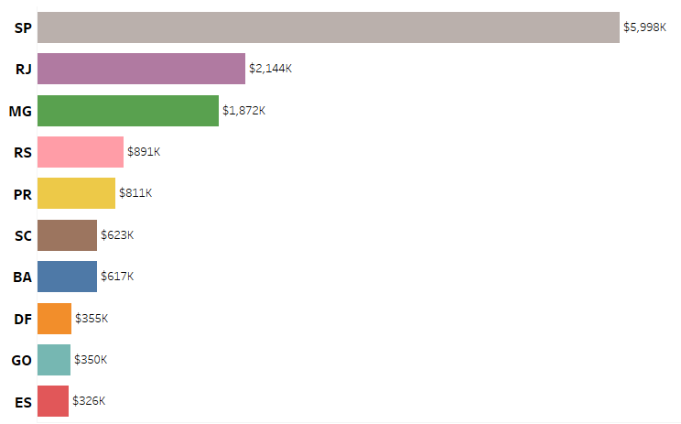
Top 10 Customer States
The present chart shows the top 10 cities where the with number of customers.
Here, it can be noticed that the highest number of customers belong to “SP” which “Sao Paulo”.
Thus, we can also interpret with this , as the maximum number of customers of Olist store belong to “Sao Paulo city” that’s why they also receive the maximum payment value from the same city.

Slide 16
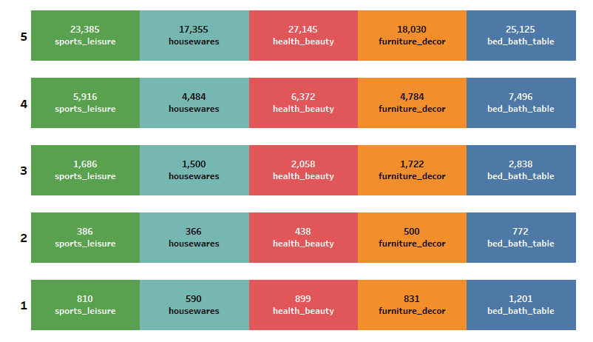
Top 5 Products Vs. Review Scores
The present chart highlights the relationship between top 5 product categories and their relative review scores.
It can be seen here that the product category “bed_bath_table” have got the highest number in all the five ratings which proves why the same category is having highest numbers of order counts in terms of sales.

Slide 17
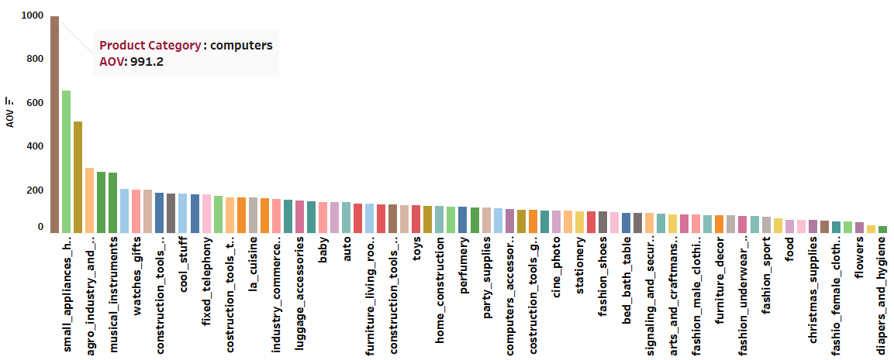
Average Order Value By Product Category
The above chart shows that the computers category has the best avg_order_val which indicates customers are spending more on average in purchasing items from this category, i.e. the computers category has more expensive products than the bed bath table category.

Slide 18
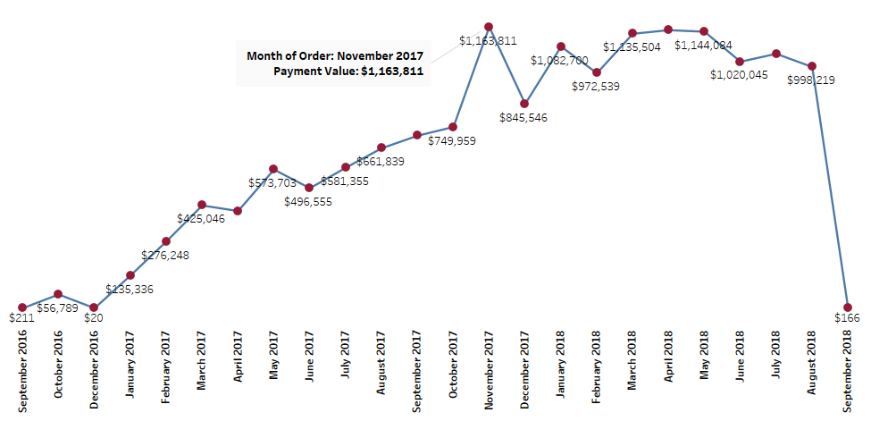
Monthly Revenue Pattern
The present chart describes the pattern of revenue over the given 2 year time period from Sep,2016 to Sep,2018.
It can be noticed that the company was able to achieve maximum sales in Niv, 2017 amounted to $11,63,811.

Slide 19
Conclusion
We have found that people prefer to buy more on week-days than wee-end from Olist online store.
Maximum review score i.e; 5 is assigned to credit card payment type by the customers.
Maximum shipping days i.e; 21 is taken for the product category “fashion_shoes” and minimum time is taken for “arts and craftmanship”.
Maximum customer density belongs to Sao_Paulo city consequently the same city provides the highest average payment value and price to Olist store, i.e; 88% of total avg payment value and average price is 89% of total avg price.
There is found an inverse relationship between shipping days and review scores which means higher the shipping days lesser the review scores and vice versa.
The highest count of orders is found for the product category “bed_bath_table” though it was found on 2nd number of “top 5 product by revenue”.
“health_beauty product category provides the highest revenue to “Olist store”.
“furniture_decor” product category provides the highest profit to “Olist store” though it was found at number 4 in the revenue category.
Product category “bed_bath_table” have got the highest numbers in all the five ratings leading to highest numbers of order counts in terms of sales in the same category.
The average order value of the product category “computers” is highest among all the categories.
The company is found to be in almost increasing trend over the given time period of 2 years and it was able to achieve the maximum sales in Nov, 2017 amounted to $11,63,811.

Slide 20
Recommendations
Olist should carefully employ different pricing strategies to maximize it’s sales performance, profitability, and customer satisfaction, e.g. employ the use of Cross-sales promotion strategies for products with high AOV like computers, and small appliances to boost sales and profitability.
Olist needs to employ loyalty programs to help improve customer retention rates. Customers seem to be satisfied with their orders based on the result of the low customer cancelation rate. Olist will have to capitalize on this by putting positive customer feedback on its platform to help attract new and potential customers.
Olist can implement dynamic pricing strategies for low-profit margin products like home appliances by offering discounts during slow periods or raising prices during peak seasons to improve profitability and optimize sales.
promotion methods like volume discounts on computers, their accessories, and other high average order value products. This will ensure they are price competitive in the market. Customers might have been getting
better deals and promotions from competitors.
Sao Paolo retained over maximum customer density across all Olist customer cities but has a very low retention rate. Olist must prioritize states like Sao Paolo and Rio de Janeiro by offering sales discounts, free shipping, and returns.

Slide 21
THANK-YOU

